Slide 1
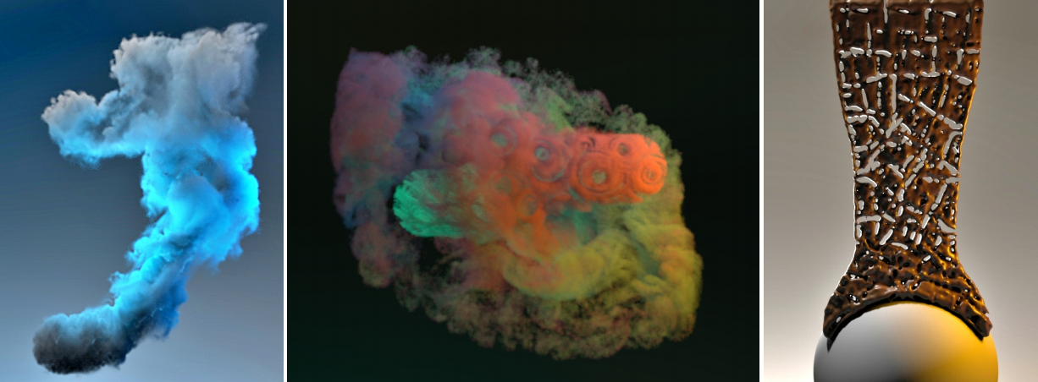
2020 SIGGRAPH
Lagrangian Neural Style Transfer for Fluids
Byungsoo Kim, Vinicius C. Azevedo, Markus Gross, Barbara Solenthaler
22051105 朱融晨

Slide 2
Introduction
Related Work
Neural style transfer
Hybrid Lagrangian-Eulerian Fluids
目录
Methods
Transfer technique
Two Strategies
Multi-scale density representation
Result

Slide 3
Introduction
Related Work
Methods
Results
Contribution
seamless integration of
neural style transfer into existing content production workflows
Lagrangian
3D fluids simulation
Neural Style Transfer

Slide 4
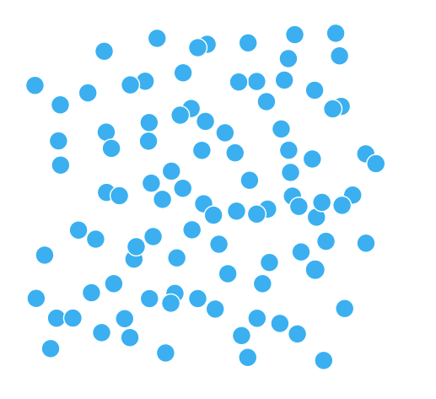
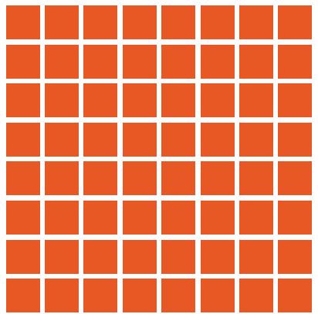
Introduction
Related Work
Methods
Results
Hybrid Lagrangian-Eulerian Fluids
Lagrangian representation
Eulerian representation

Slide 5
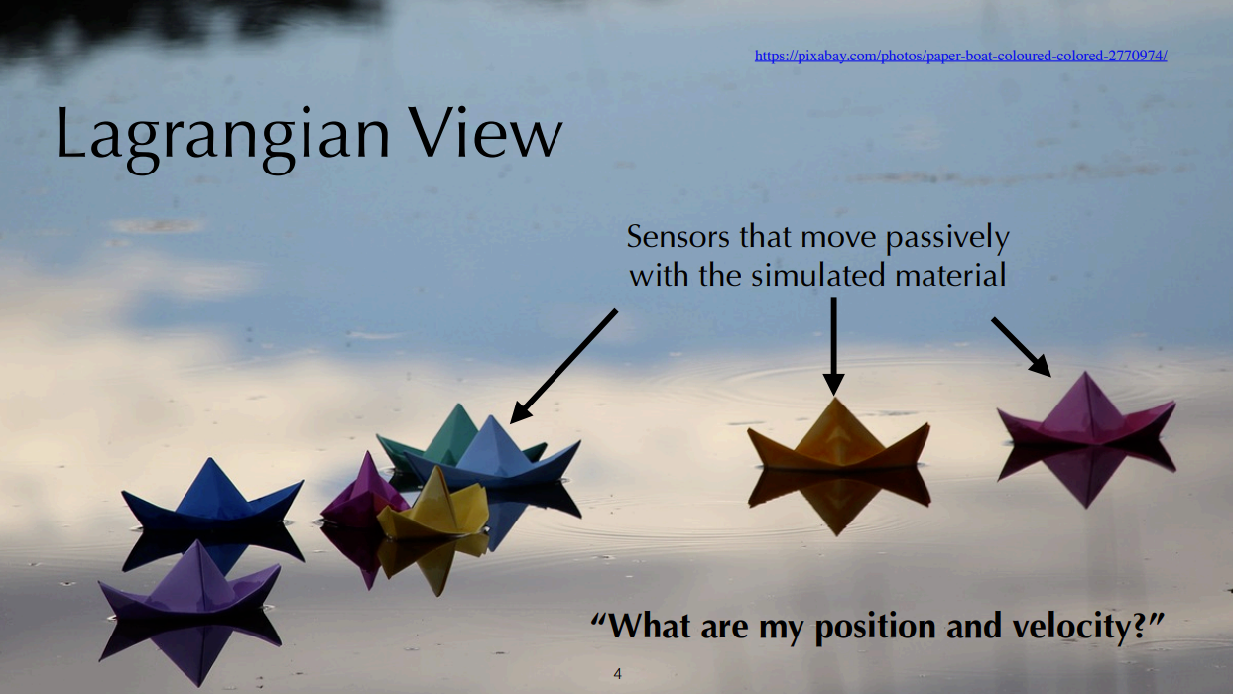
Notes:
随波逐流，每时每刻都在问自己一个问题，位置和速度

Slide 6
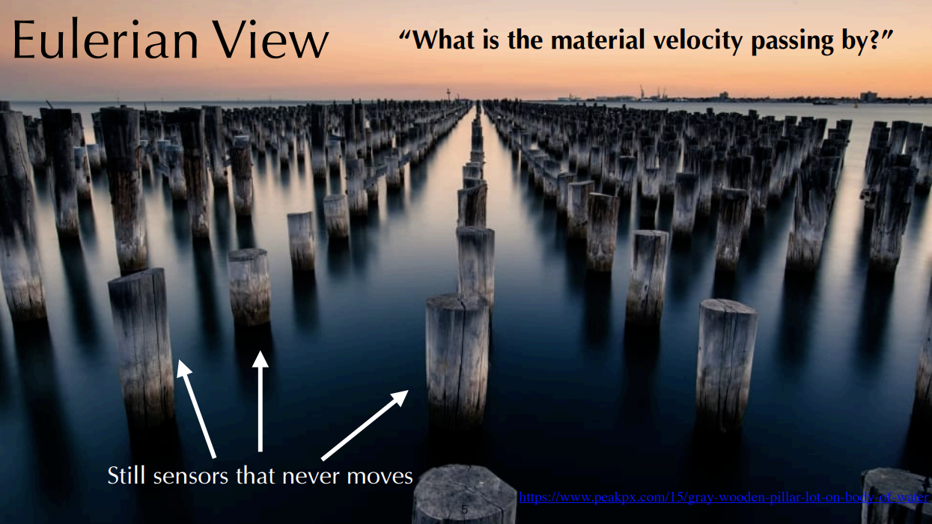
Notes:
从来不移动，经过它的位置的材料

Slide 7
Introduction
Related Work
Methods
Results
Hybrid Lagrangian-Eulerian Fluids
projection
Eulerian
易于离散化、高效的领域访问、设置初始值
无法精确处理场的流动
advection
Lagrangian
易于更新粒子的运动状态、
邻域访问需要复杂的数据结构实现

Slide 8
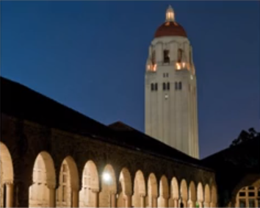
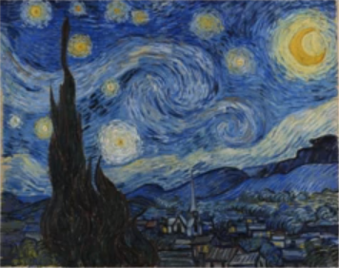
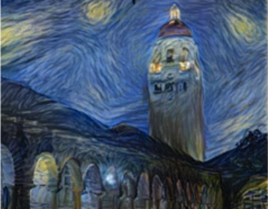
Introduction
Related Work
Methods
Results
Neural Style Transfer
Content
Style
Generated Image
[Gatys et al., 2015. A Neural Algorithm of Artistic Style. ]

Slide 9
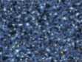
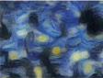
Introduction
Related Work
Methods
Results
CNN
[Gatys et al., 2015. A Neural Algorithm of Artistic Style. ]

Slide 10
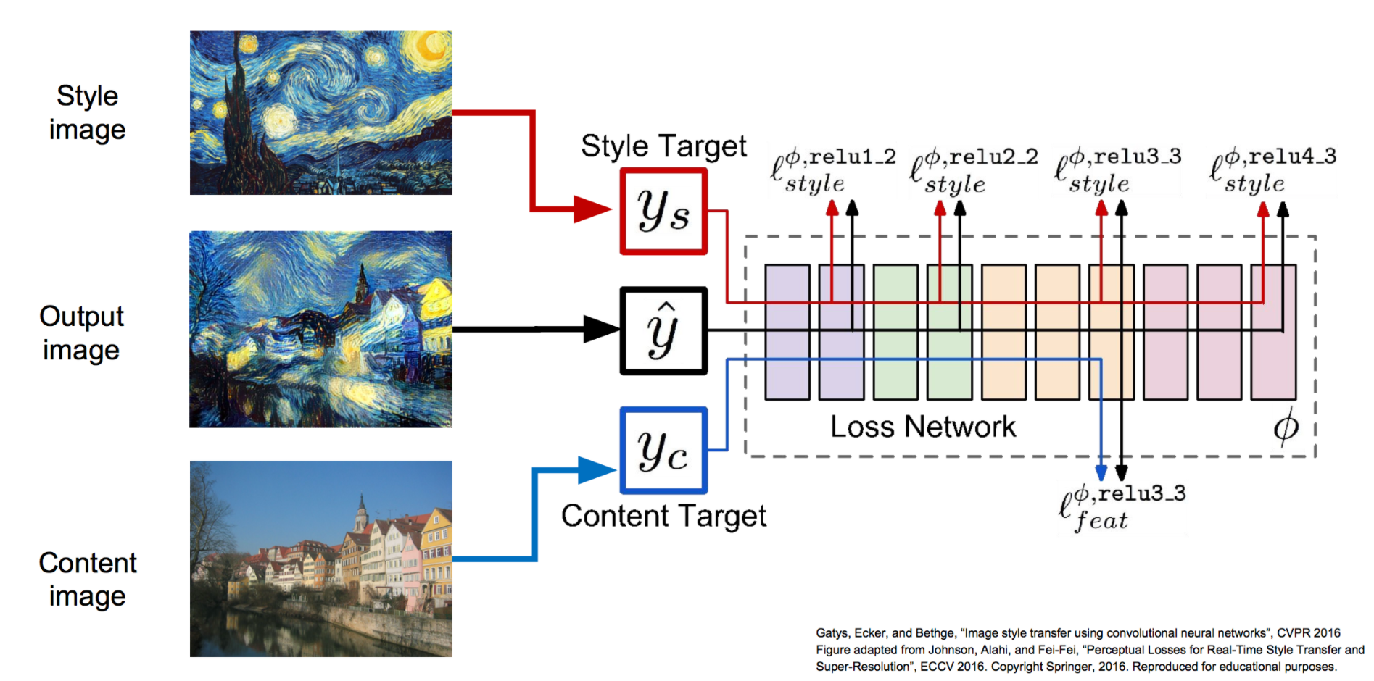
Introduction
Related Work
Methods
Results
Notes:
同时优化特征反演和纹理生成的损失函数（与gram矩阵的距离以及与激活图的距离的加权和），使得生成图既具有Content image的空间结构，又具有Style image的纹理结构。

Slide 11
Is Style Transfer For Fluid Simulations Possible?

Slide 12
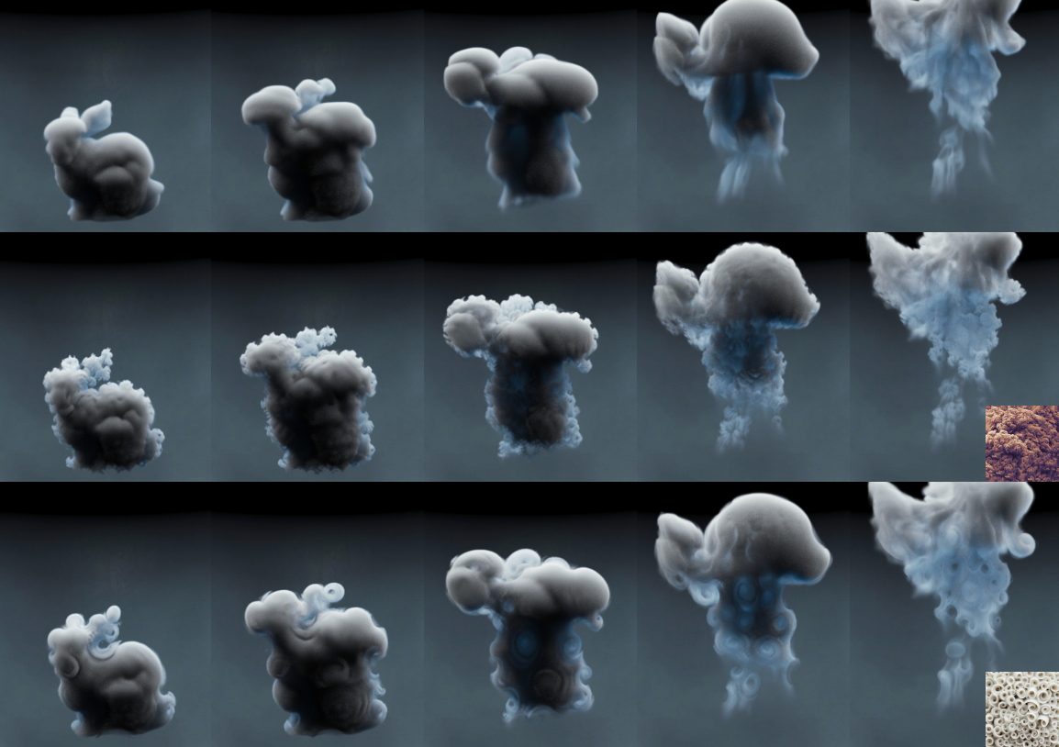
Introduction
Related Work
Methods
Results
Eulerian Transport-based TNST
2D image
Flow-based 3D smoke density
pixels
A velocity
field
[Kim et al. 2019, Transport-based neural style transfer for smoke simulations ]

Slide 13
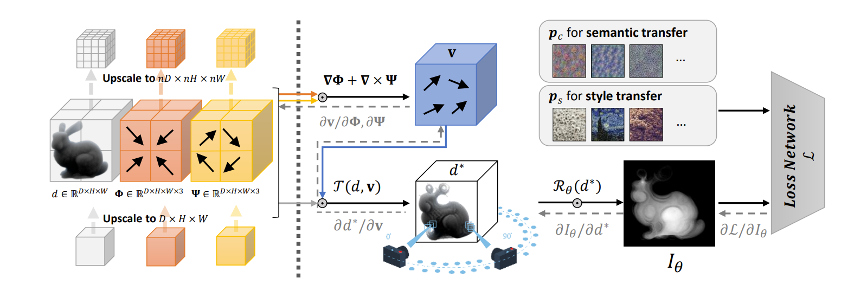
Introduction
Related Work
Methods
Results
Eulerian Transport-based TNST
[Kim et al. 2019, Transport-based neural style transfer for smoke simulations ]

Slide 14
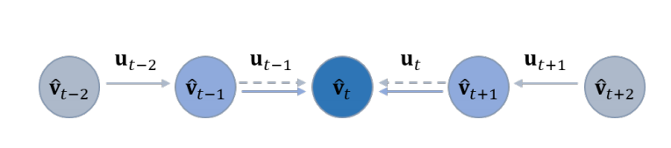
Introduction
Related Work
Methods
Results
Eulerian Transport-based TNST
Recursive temporal alignment in TNST
[Kim et al. 2019, Transport-based neural style transfer for smoke simulations ]

Slide 15
Why not use Lagrangian View ?

Slide 16
Introduction
Related Work
Methods
Results
Hybrid Lagrangian-Eulerian Fluids
粒子
欧拉网格
分布
更新
advection
projection

Slide 17
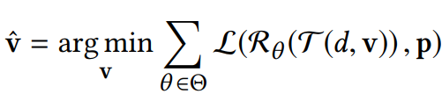
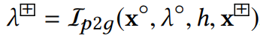
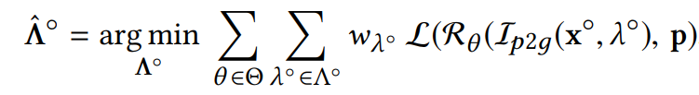
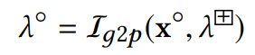
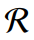
Introduction
Related Work
Methods
Results
Lagrangian NST
TNST
: a differentiable renderer converting the density field to image-space for a specific θ view
Notes:
这个好像不是很清晰。

Slide 18
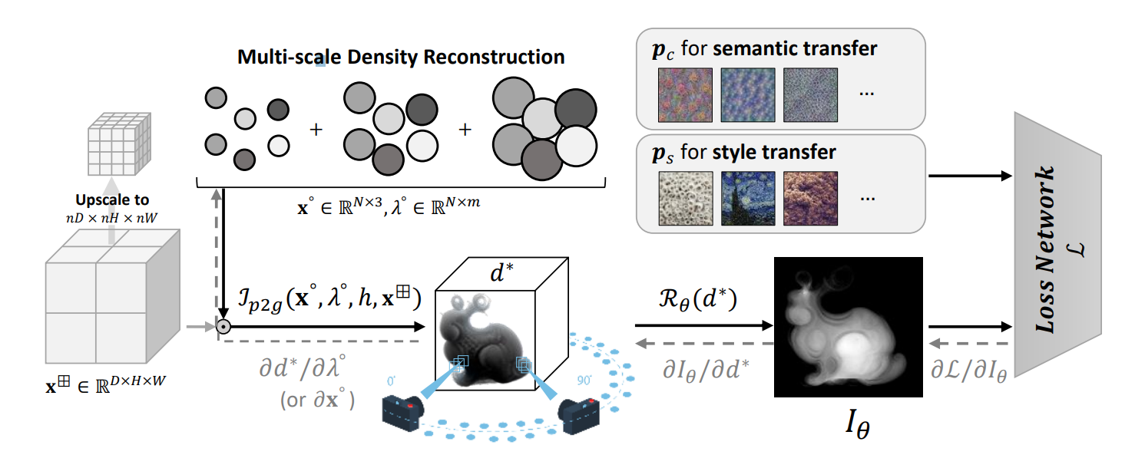
Introduction
Related Work
Methods
Results
Lagrangian NST
使用TNST方法的损失评估方法，只是扩展了方法的使用范围

Slide 19
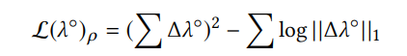
Introduction
Related Work
Methods
Results
LNST： two strategies
Suitable for participating volumetric data, which are often simulated with grid-based solvers
reinforces the conservation of the original amount of smoke

Slide 20
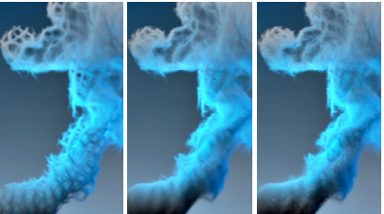
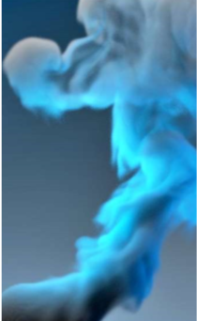
Introduction
Related Work
Methods
Results
LNST： two strategies
Higher Weight

Slide 21
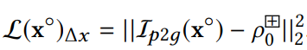
Introduction
Related Work
Methods
Results
LNST： two strategies
Suitable if the underlying fluid solver is particle-based solvers or hybrid
Penalize irregular distribution of particle positions
ρ ⁺ ₀ corresponds to the rest density for cells that contain particles, and is zero otherwise,

Slide 22
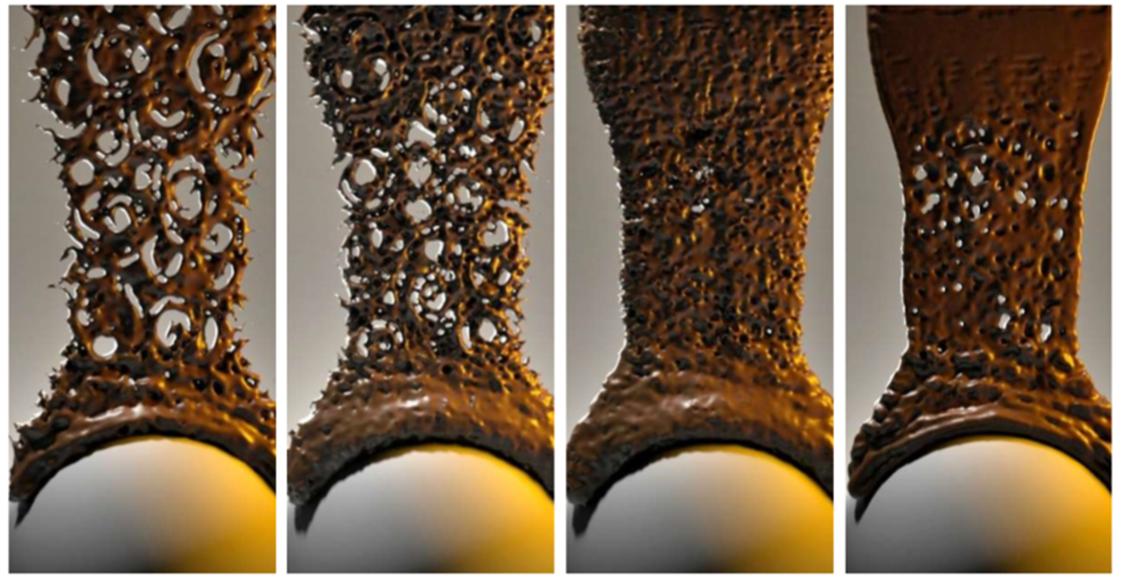
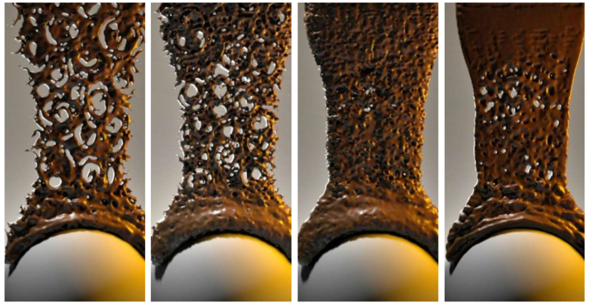
Introduction
Related Work
Methods
Results
LNST： two strategies
Higher Weight

Slide 23
Introduction
Related Work
Methods
Results
multi-scale density representation
Grid-based simulation
One particle per voxel
Sample and resimulate particles
positions
densities
Strategy 2
Multi-scale density
representation

Slide 24
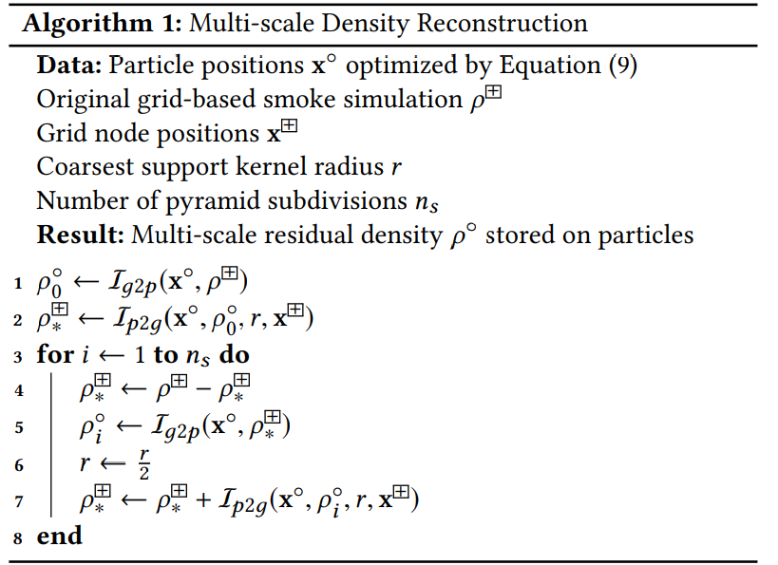
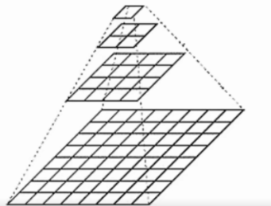
Introduction
Related Work
Methods
Results
multi-scale density representation
向上采样

Slide 25
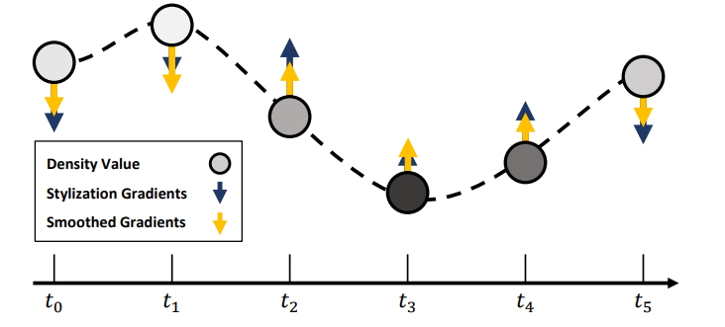
Introduction
Related Work
Methods
Results
LNST: temporal coherency
inexpensive enforcing of temporal coherency.
neural style
gradients
Gaussian filter
density
Notes:
因为粒子携带属性值，所以很容易追踪属性值随着时间的变化。在网格上算梯度的变化。对于密度随时间的变化量应用高斯滤波器

Slide 26
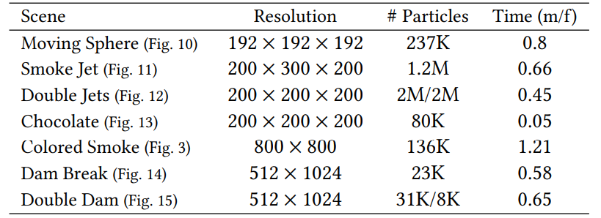
Introduction
Related Work
Methods
Results
实验环境：a TITAN Xp GPU (12GB)
Performance

Slide 27
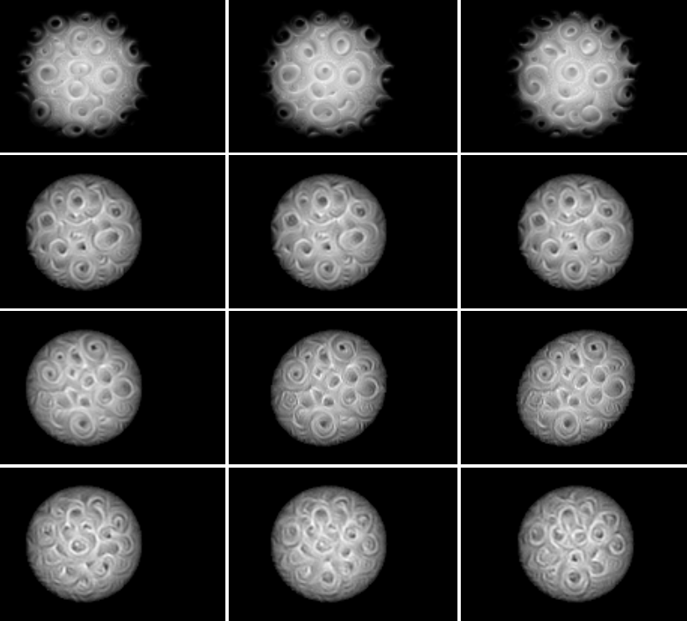
TNST
Time-coherency
LNST
Selected frames
of a stylized moving
smoke sphere
shearing
noise

Slide 28
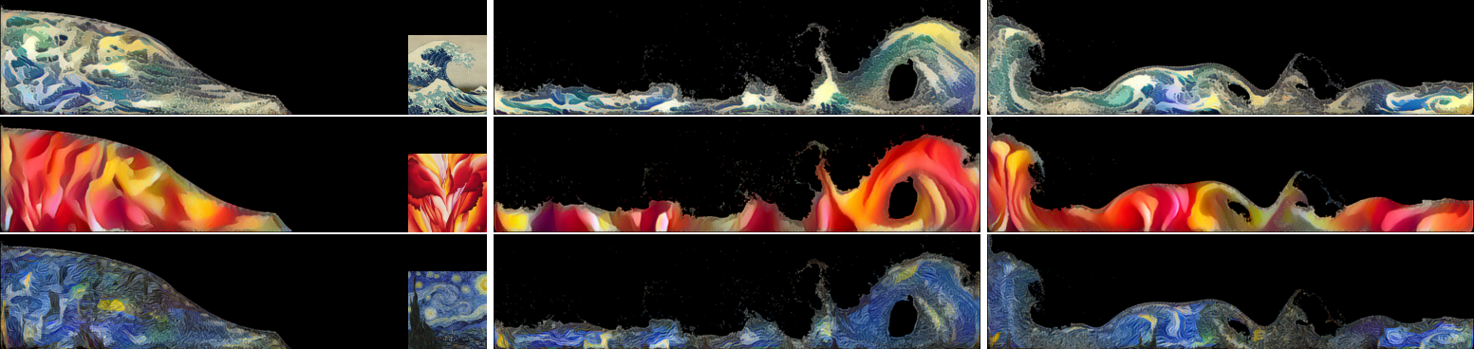
Introduction
Related Work
Methods
Results
Color Transfer
Lagrangian color stylization applied to a 2D particle-based liquid simulation
using the input images Kanagawa Wave, Red Canna and Starry Night.

Slide 29
Introduction
Related Work
Methods
Results
Pros
Quality: improved temporal coherence
Performance: stylization per frame in less than a minute
Art-directability: multi-fluid stylization, color transfer, liquid stylization
Cons
Liquid renderer: now simple and the render must be differentiable
Not tested the method on large-scale simulations
for testing different input structures, a real-time method would be desirable

Slide 30
Thanks

